Slide 1

ANALYSIS OF GROSS COLLECTION
OF
MOVIES

Slide 2
About Us:-
Name:-M.ROHITH KUMAR REDDY
Qualification:-B-Tech
Name:-CH.SATISH
Qualification:-B.COM(C.A)

Slide 3
Problem Statement:-
Box Office Revenue:
Start by looking at the overall box office revenue generated by the movie. This includes USA collections.
Box office figures are often reported weekly or weekend-wise, and the total gross is calculated over the movie's entire theatrical run.
So we have Analyzed the Daywise,Monthly and Yearly Data for 2022 and 2023.
Tools Used:-
Request
Beautiful soup
Pandas
NumPy
Matplotlib
Seaborn
Regex

Slide 4
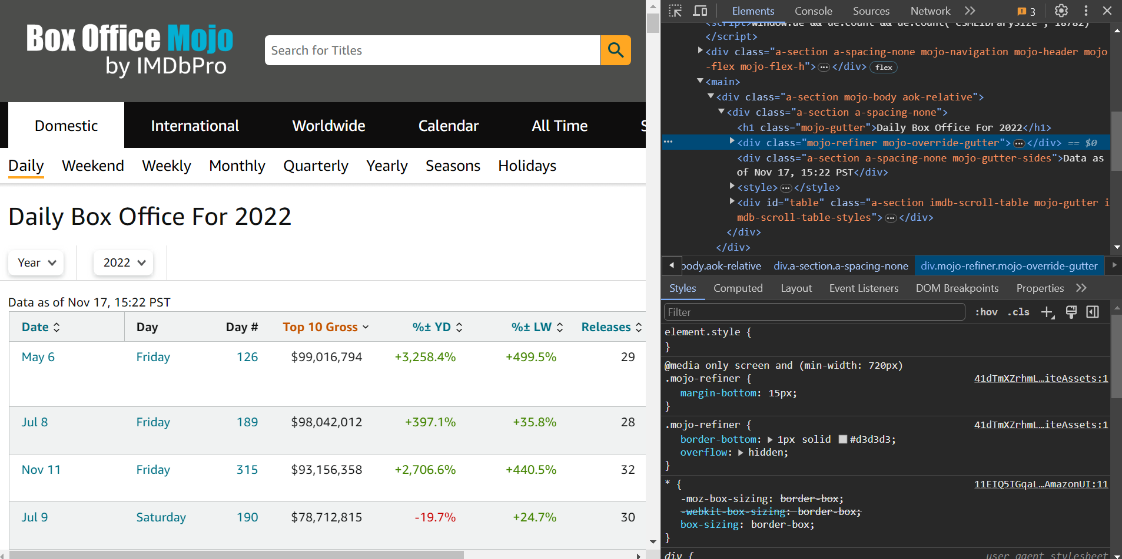
Web Scraping:- Website url:- https://www.boxofficemojo.com/

Slide 5
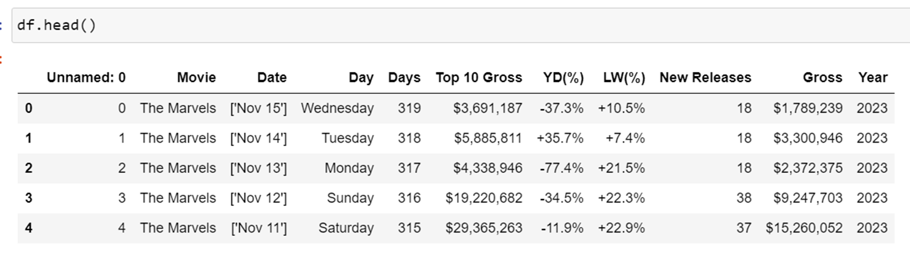
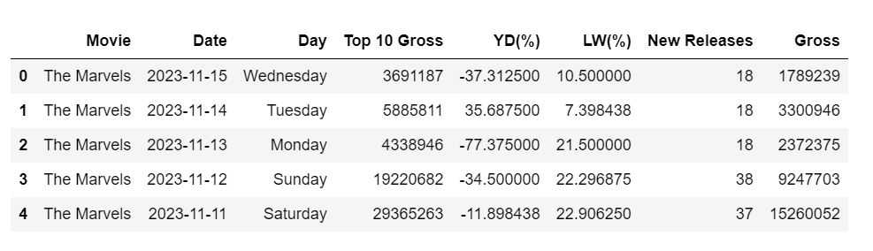
Data Cleaning:-

Slide 6
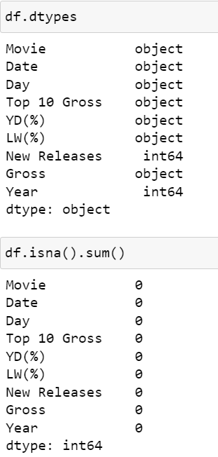
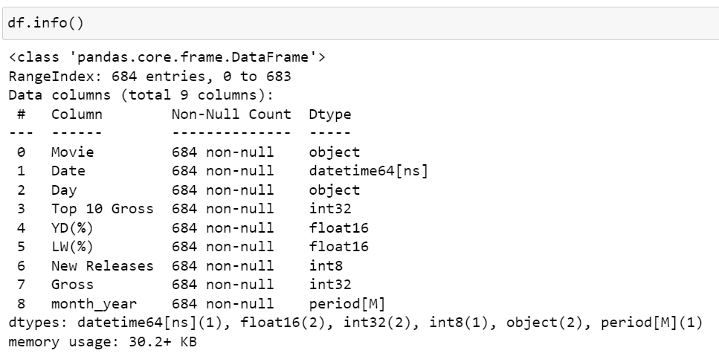
Converting the Data Types:-

Slide 7
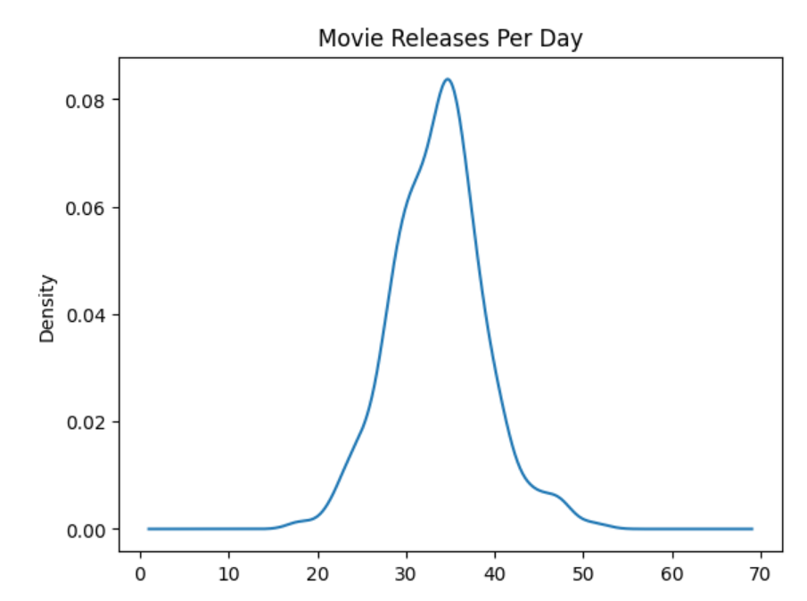
Univariate Analysis:-

Slide 8
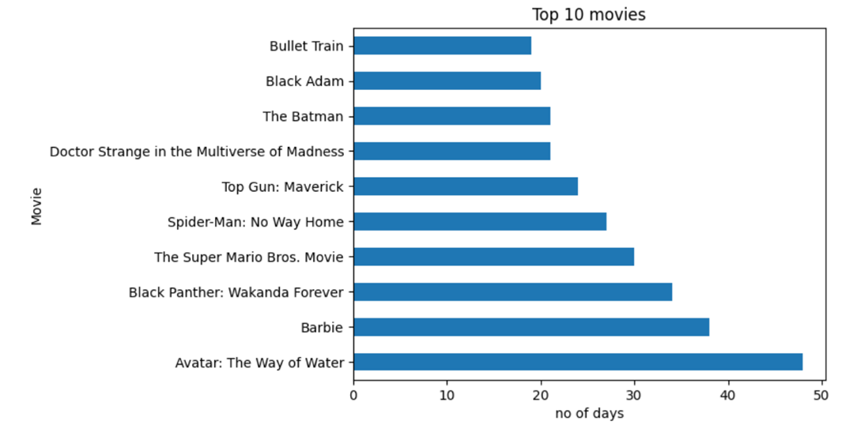
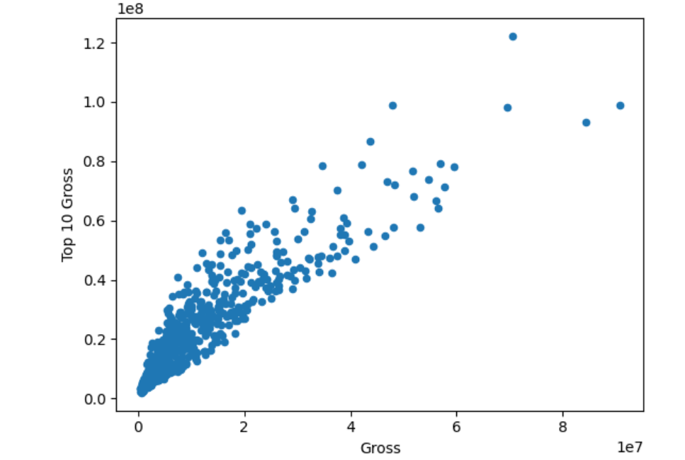
Bi-Variate Analysis:-

Slide 9
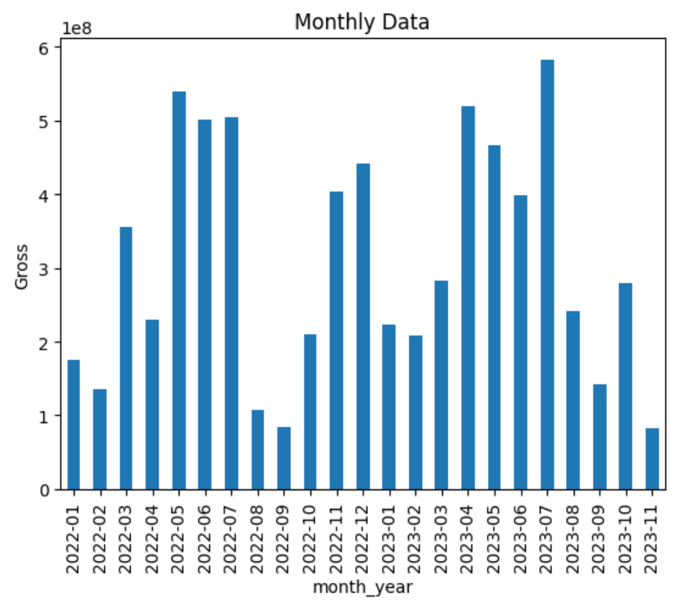
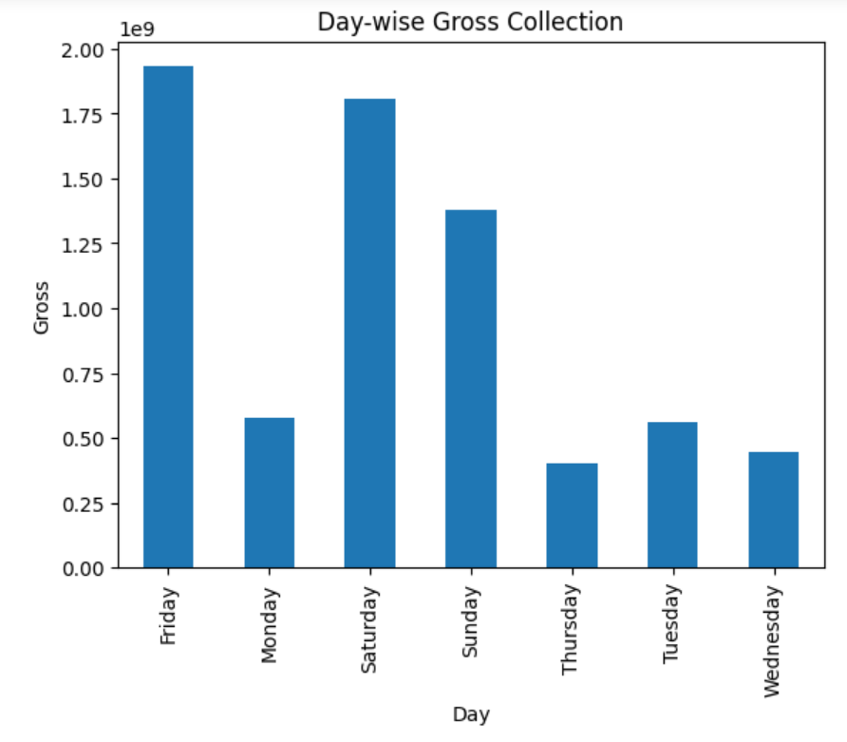
Bi-variate Analysis:-

Slide 10
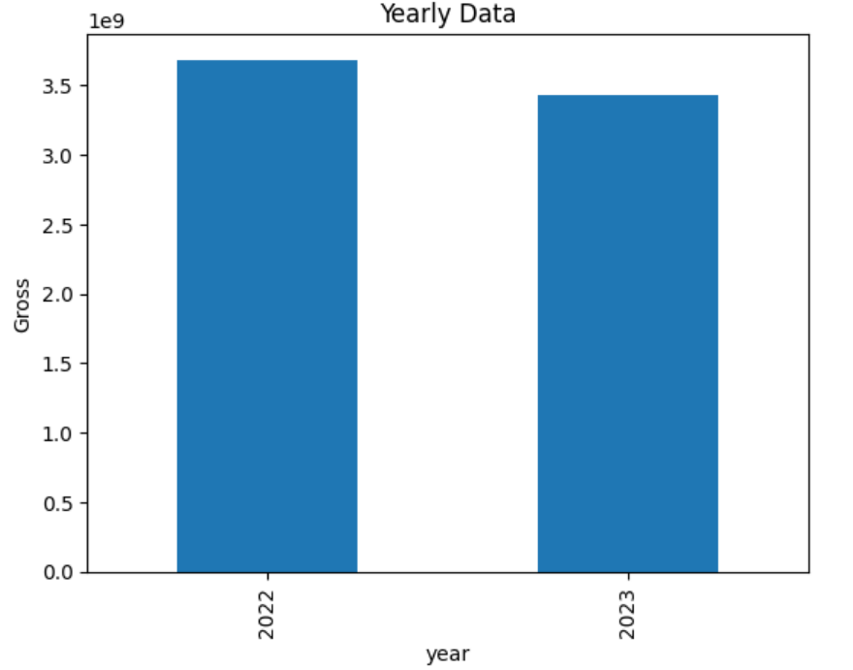
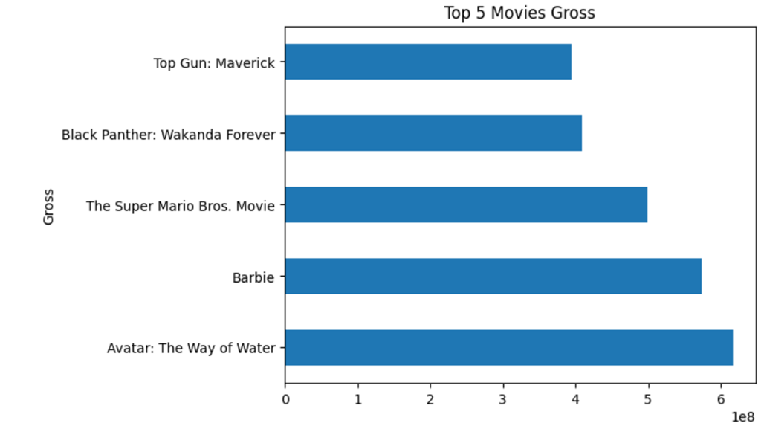

Slide 11
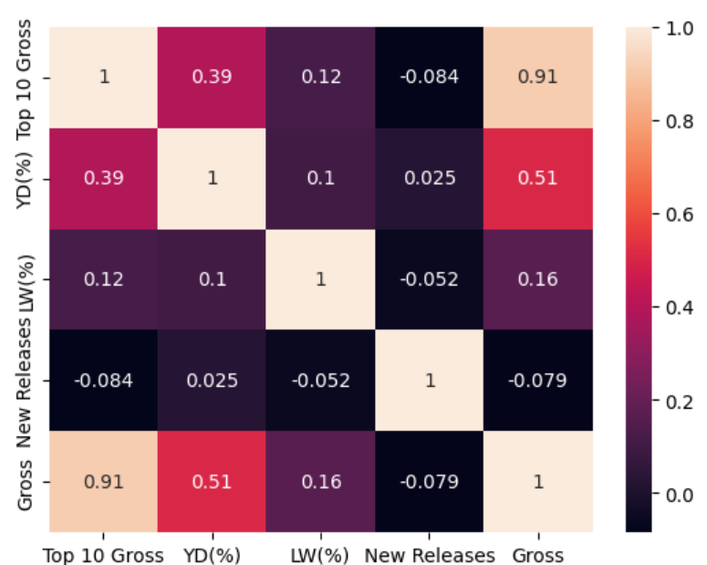
Multi variate Analysis:-

Slide 12
Conclusion:-
From the above graphs it is concluded that the Movie Avatar has got more Gross Collection.
And we can clearly observe that on Friday the Gross Collection is More.

Slide 13

THANK YOU

